Slide 1
LINEAR EQUATIONS

Slide 2
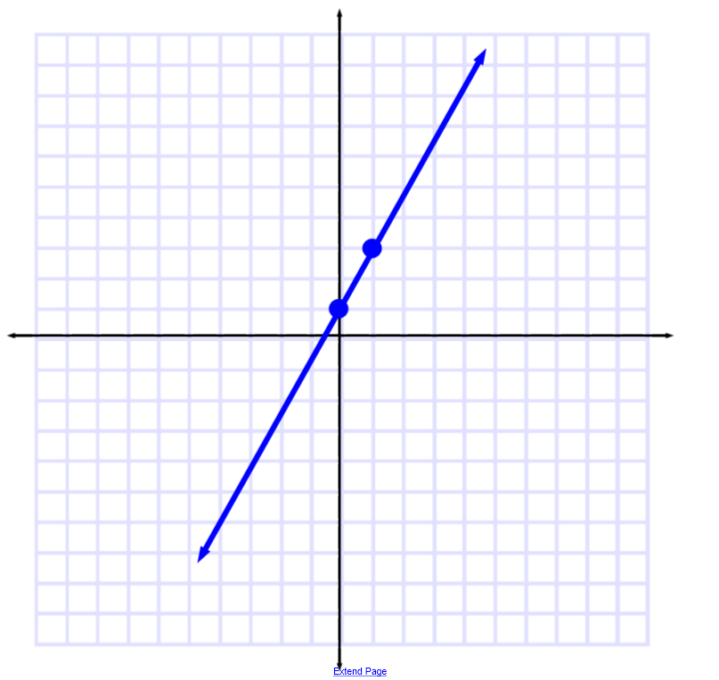

Slide 3
What is SLOPE?
Gradient or tilt of the line
Gives direction:
Positive slope: up to the right
Negative slope: down to the right
Gives steepness:
Higher the magnitude (larger absolute value of slope), the steeper
Closer to zero (smaller magnitude), less steep

Slide 4
What is SLOPE?
$m= \frac{y2 −y1}{x2 − x1}$ = $\frac{rYse}{run}$ = $\frac{change in y}{change in x}$
Is $m= \frac{y1 −y2}{x1 −x2}$okay?
Is $m= \frac{y1 −y2}{x2 −x1}$okay?
Is $m= \frac{x2 −x1}{y2 −y1}$okay?
YES! It has change in y over change in x and keeps coords in same order
NO! Coords *ARE NOT* in same order
NO! It is *NOT* rYse over run … change in y over change in x

Slide 5
What is y-intercept?
Where the line crosses the y-axis
It is a constant
Represented by the letter b

Slide 6
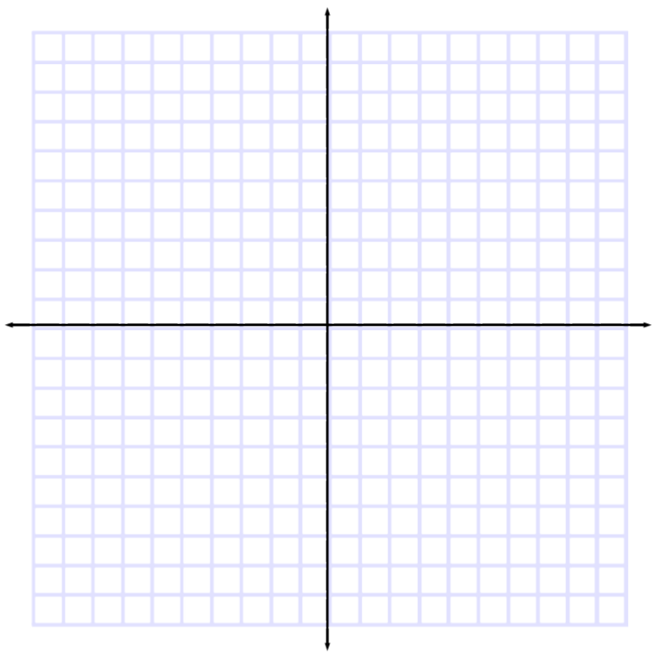
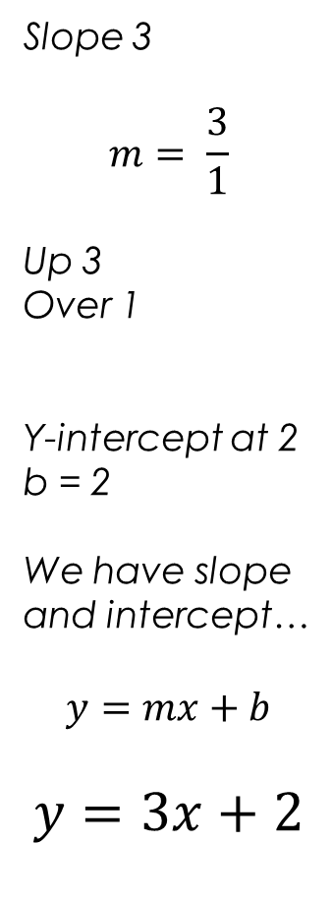
Write an equation for the
with slope 3
crossing the y-axis
at 2.
Slope 3
$$m= \frac{3}{1}$$
Up 3
Over 1
Y-intercept at 2
b = 2
We have slope and intercept…
$$y=mx+b$$
$$y=3x+2$$

Slide 7

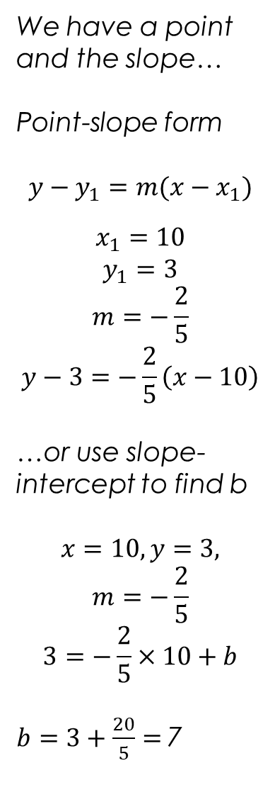
We have a point and the slope…
Point-slope form
$$y−y_{1}=m({x−x}_{1})$$
$$x_{1}=10$$
$$y_{1}=3$$
$$m=−\frac{2}{5}$$
$$y−3=−\frac{2}{5}\left(x−10\right)$$
…or use slope-intercept to find b
$$x=10, y=3,$$
$$m=−\frac{2}{5}$$
$$3=−\frac{2}{5}×10+b$$
$b=3+\frac{20}{5}=$7
Write an equation for the line passing through (10, 3)
with slope $−\frac{2}{5}$
$$y=−\frac{2}{5}x+7$$

Slide 8
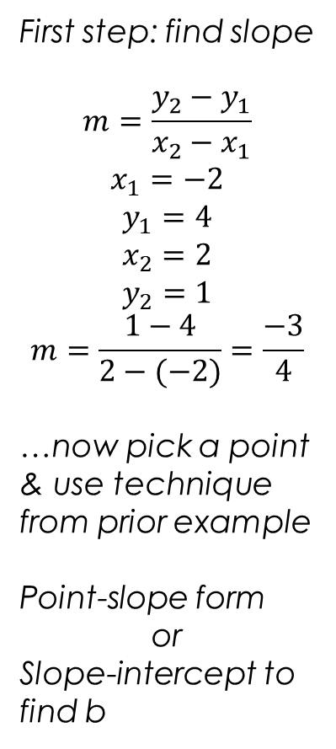

First step: find slope
$$m=\frac{y_{2}−y_{1}}{x_{2}−x_{1}}$$
$$x_{1}=−2$$
$$y_{1}=4$$
$$x_{2}=2$$
$$y_{2}=1$$
$$m=\frac{1−4}{2−(−2)}=\frac{−3}{4}$$
…now pick a point & use technique from prior example
Point-slope form
or
Slope-intercept to find b
Write an equation for the line passing through
(-2, 4), (2, 1)
$$y=−\frac{3}{4}x+\frac{5}{2}$$

Slide 9
Visualization
Equation:
Abstraction of the line
Gives you the entire line, allows predicting what will happen anywhere along that line
Graph:
Can only see part
Must be considered an approximation
Tangible, visible representation

Slide 10
Distance Formula
Square root
$\sqrt{\left(x_{2}−x_{1}\right)2+(y_{2}−y_{1})2}$
of the sum
of the squares of the differences along each axis

